Slide 1

SELF EMPOWERMENT
Empowerment is a process through which individuals in disadvantaged positions augment their access to knowledge, resources and decision making power.
It raises their level of awareness and ability to participate in community activities thus attaining a level of control over their own environment.
According to Bandura 1986, empowerment is the process through which an individual gains efficiency and skills to control one's own environment.
According to Masi et al. 2003 self-empowerment is an individual's ability to make decisions, have control over his or her personal life and characterize it by a sense of perceived control, competence and goal internalization.

Slide 2
Dimensions of Self-Empowerment
Physical dimension
Psychological dimension
Cognitive dimension
Control over one's own mobility and physical condition including health.
Level of self-confidence and self-esteem.
Awareness and understanding of one's own condition.
Economic dimension
Political dimension
Ability to access resources, engage in productive activities and take independent decisions.
Ability to set their own agenda, negotiate, lead and organize for altering the conditions.

Slide 3


Self-empowerment Development
Empowerment can be achieved through education, organization, entrepreneurship, science and technology, information technology, microfinance institutions and law.
Development Phases
Empowerment takes place over three phases -individual level, interpersonal level and societal level.
Education
Education plays the most important role in empowerment. It enables development of knowledge and skills for attaining self-independence.
Organizations
Organizations are the main source of power and strength for fighting collectively against age old practices such as dowry harassment, child marriage, domestic violence, devadasi system, etc.

Slide 4


Entrepreneurship
Entrepreneurship encourages individual's participation in the labor force besides augmenting his position in the society. Micro entrepreneurship on the other hand strengthens empowerment and reduces gender inequality.
Science and Technology
Science and technology can be effectively used to ease workload within and outside the house, involve individuals as equal partners, recognize their knowledge experience and the significant role that they can play in sustainable development.
Information Access
Access to information is the key for empowerment as it provides various options to livelihood, education, health services and e-commerce.
Microfinance
Microfinance programs play a dominant role in empowerment of low-income individuals as they grant access to various saving schemes and other financial services.
Law
Law ensures protection of individual rights such as protection of underprivileged women from injustice, wrongful eviction, abuse and exploitation. It guarantees equal opportunities to individuals for accessing various resources.

Slide 5
Strategies to Promote Self-empowerment
1. Know yourself
1
Understand your motivations, strengths and weaknesses.
2
2. Improve your knowledge and competencies
Focus on gaining expertise and improving skills or qualities that will allow us to reach our goals.
3. Create an action list
3
List out the required to achieve that out the actions reflect on the achievements after making initial progress and adjust the approach if necessary.
4
4. Develop a positive attitude
Cultivate a positive attitude and outlook rather than giving in to concepts such as fate, luck or circumstances.

Slide 6
8. Practice self-care
7. Develop a strong community
It includes all activities such as eating right and exercising, scheduling time to relax and rejuvenate so as to make ourselves more productive.
6. Identify your goals
5. Use positive self-talk
Identify the most important aspects of your life where you can create a meaningful change and set measurable and achievable goals.
Seek friends and partners that share our values to who appreciate, affirm and constructively challenge our ideas and contributions can boost our confidence.
Focus on what you can do as opposed to what you can't.

Slide 7

Women Empowerment
Definitions of Women Empowerment
According to Pillai 1995, women empowerment is an active, multidimensional process which enables women to realize their full identity and powers in all walks of life.
World Bank 2001. defines women em-powerment as the expansion of freedom of choices and actions which could increase women authority and control over resources and decisions pertaining to their life.

Slide 8

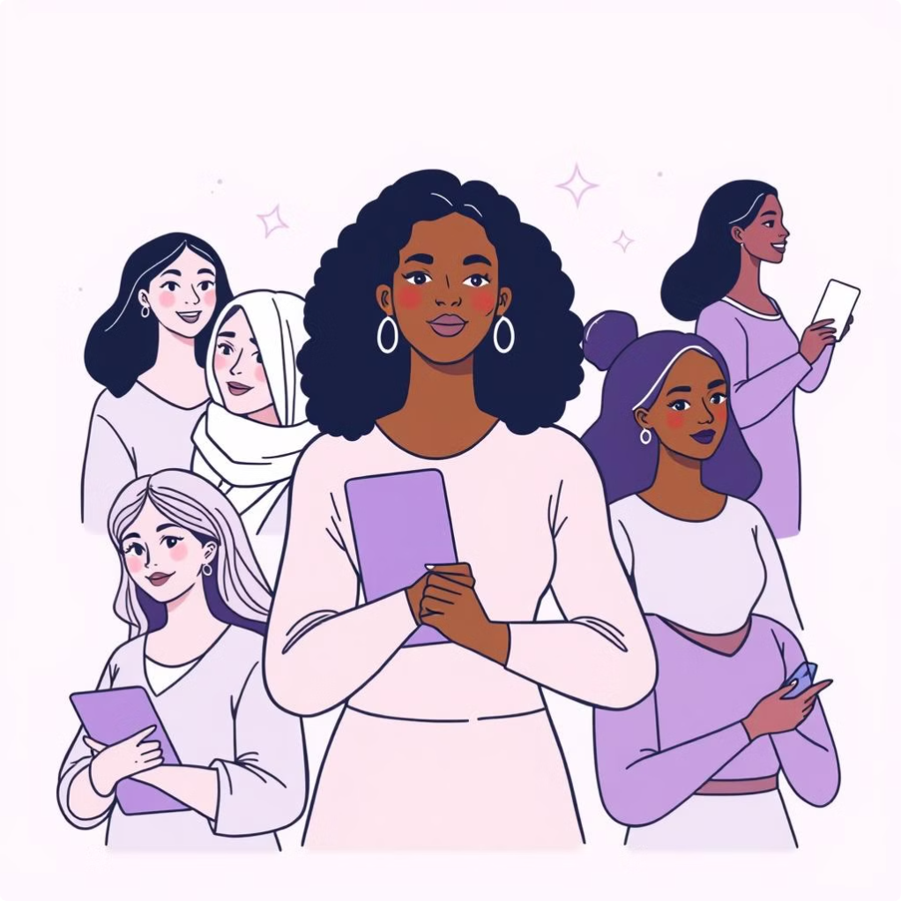
Dimensions of Women Empowerment
Women empowerment is a multidimensional concept as it covers financial independence, social awareness and political consciousness of an individual. These elements can be categorized into social, economic and political empowerment.
1. Social empowerment means an equitable social status for the women in the society. Some of the steps taken by the government are universalization of elementary education, promoting balwadis and crèches, encouraging distance and non-formal adult education, establishing women hostels and creating multipurpose institutions.
2. Economic empowerment means providing financial independence to women and accounting their contribution by removing all gender specific barriers that prevent women from gaining access to their rightful share in every sphere of life.
3. Political empowerment for women means establishing their public presence by increasing their mobility and breaking their isolation from the decision making process. It improves their self-confidence and enhances self-image.

Slide 9
Importance of Women Empowerment in Society
Gender equality
Autonomy
Economic development
Empowerment of women is necessary to achieve gender equality in terms of equal rights, opportunities and obligations.
Empowerment enables women to acquire control over material assets, intellectual resources and ideology.
Economic sustainability can only be attained by providing them with equal opportunity for education, work and entrepreneurship.
Education and knowledge
Health and wellbeing
Violence and discrimination
Women with adequate education are more competent and self-assured which allows them to engage in social, economic and political spheres actively.
Being empowered puts them in a better position to take care of their health, seek medical attention when necessary and improve their wellbeing.
Challenges to harmful practices such as domestic abuse, sexual harassment, human trafficking can only be made possible by empowerment of women.

Slide 10
Leadership and decision making
Social and cultural change
Realize full potential
Women empowerment is probably the most logical way to challenge societal and cultural conventions that support gender inequality and prejudice, and advance a culture that honors and respects women's contribution.
It enables women to inculcate a sense of self-confidence and independence thereby realizing their full potential and face challenges in various spheres of life.
It is the only way to ensure that they have an equal voice in decision making at domestic and public level.

Slide 11




Barriers to Women Empowerment
Lack of access to resources
Discriminatory societal norms
Unequal domestic responsibilities
Gender discrimination
Women are considered as weaker section of the society and therefore given lesser importance.
Around the world, women are significantly less likely than men to have access to productive resources such as land, finance and information.
In most households there is a deep belief that women should not exist in many different contexts in their homes, communities and workplaces
Around the world, women shoulder disproportionate responsibility for domestic work and unpaid care.

Slide 12




Gender based violence
Disparity in education
Lack of legal and political support
Limited mobility
Women workers across the world are at some instance or the other subjected to intimidation, hostile or humiliating work environment which not only limits their economic opportunities but also contributes to gender job segregation.
In the modern era though the level of women education is catching up with men education, female illiteracy continues to be higher in rural areas.
Women are at times subject to greater restrictions when it comes to moving across places and getting access to various forms of transportation.
Women usually enjoy limited legal and political support including limited representation in the Government and limited access to legal protection and services.

Slide 13


PROFESSIONAL ETIQUETTE
Etiquette is a code of good manners, the polite rule of a society or a professional group.
In the context of nursing, etiquette not only includes the nurse's behavior towards patients and colleagues but also the establishing of a relationship with patients, colleagues and supervisors.
To ensure smooth functioning the nurse should follow certain professional etiquettes.
It is good etiquette that leads to good interpersonal relationships besides strengthening professional life.
For a nurse, etiquettes play an important role in her professional life. Some aspects of etiquettes are:

Slide 14

1. Posture: Posture says much about the person and reflects his/her level of confidence, attitude and interests. Some of the posture etiquettes are:
Stand straight, do not lean against a desk or a cot.
Stand with hands by sides, not on hips or in pockets or arms crossed over the chest.
When sitting, put the knees together and do not cross the legs.
Show interest and demonstrate care
Use a sincere smile to convey warmth and friendliness.

Slide 15


Verbal communication: It includes speaking and listening skills, ability to apologize, manner of addressing conflict and treating others. Some of the verbal communication etiquettes are:
Introduce self and explain one's role before providing care.
Be courteous, gentle and polite while talking Greet seniors, co-workers and patients appropriately and with a smile.
Maintain silence where necessary.
Convey thanks on receiving a favor.
Maintain eye contact, show attention when listening
Excuse oneself when interfering with others already engaged in a talk or work.
Convey thoughts clearly, practice effective communication.
Use appropriate introductions such as Ms, Mr. Mrs, Dr, etc.

Slide 16


Word choice: Selection of appropriate words is an important part of any communication.
Use polite and grammatically correct language
Select appropriate wording.
Use clear voice, right tone and volume.
Avoiding distracting behaviors: Avoid certain behaviors and conditions while in a professional environment.
It is important not to have bad breath.
Snack items should be consumed only during a formal break.
The food corner should be cleaned up after food or tea breaks.
It is highly offensive to smoke in a working environment.
Avoid constant yawning, resting head on table etc.
Keep the mobile phone in silent mode/switch it off while in a working environment.
Avoid streaming videos, playing music in work area.

Slide 17


PERSONAL GROOMING
Grooming refers to the actions carried out to keep themselves clean and presentable.
It is important to feel good about ourselves, project a positive image of self and maintain a pleasing and attractive appearance.
When we feel good about ourselves we naturally convey confidence and a positive attitude.
Professional grooming is important for all professionals. What we wear supports our professional image and sends a signal to others about how we see our self and want to be perceived by others.
Professional appearance is also important for being respected at work place.
Grooming of the nurse is an essential factor as the patient judges her ability based on her appearance.
Patients prefer the nurse to be well groomed and have a professional outlook. Personal grooming includes dress code, make up, jewellery, hair set up, etc.

Slide 18
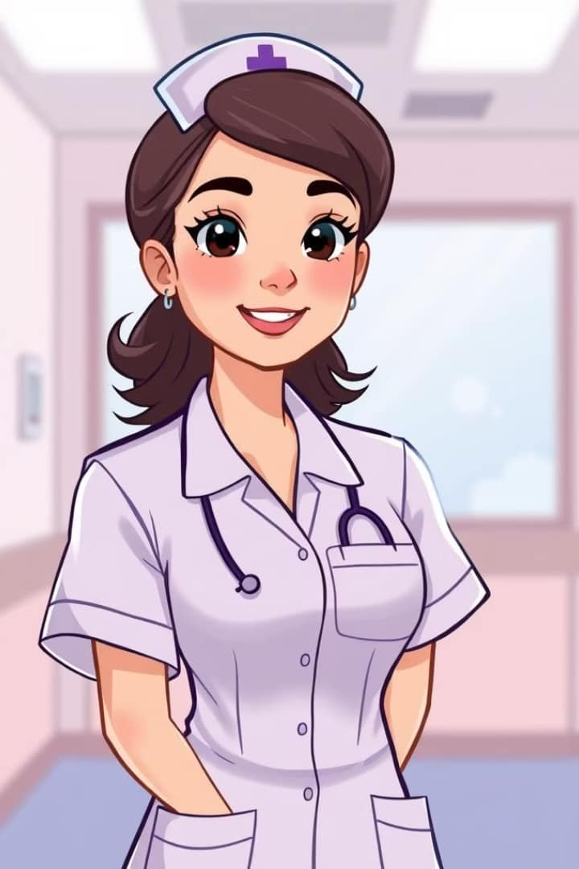
Dress Code
Wearing a proper uniform shows respect for the patient and also for the nurse herself and the work she does.
A good professional outlook allows the nurse to make a good first impression which makes the patient perceive that he is under the care of a capable healthcare professional.
It should allow free movement as the nurse is required to bend, stoop, reach and lift objects while discharging her duties.
Uniform and apron should be clean and pressed well.
Uniform skirts should not be too short.
Uniform should not be of transparent fabric
Uniform fabric should not induce irritation or heavy sweating.

Slide 19

Uniforms should be easily washable as they are subject to frequent spills and stains.
Name tag or identity card should be visible and readable.
Shoes should be clean and properly laced up.
Caps should be rightly placed on the head, not too far back or close to the front hairline.
Hair Set up
Hair should be clean, trimmed and neatly combed or arranged.
It should be tied up according to the organization policy.
When providing direct care hair should not be longer than shoulder length as it may interfere with patient care.
Attractive rubber bands and pins should be avoided.
Hair coloring must look natural.
For men hair should be above the ears and not touch the neck collar.
Moustache should be well groomed and not grown beyond the mouth corners.

Slide 20

Jewellery
Jewellery must be kept to a minimum and banned in some areas so as to safeguard from injury or transmission of infection.
While in uniform large and dangling ear rings should be avoided.
Necklaces should not show above the shirt line.
Body piercing is not advisable except for ear rings for women.

Slide 21
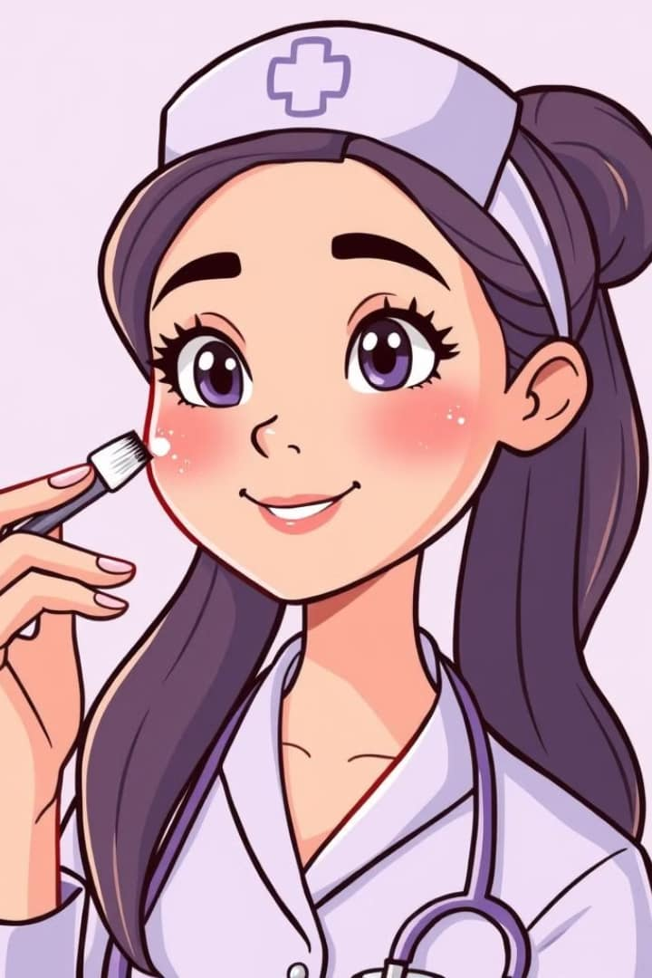
Make up
• Make up should be used sparingly.
• When used it should blend with natural skin color and features.
• Lipstick color should be conservative and compatible with the individual.
• Artificial eyelashes should be avoided.
Fragrance that smells from a distance or lingers even after leaving should be avoided.
• Scented body lotions, fragrances and colognes should not be used to excess in patient areas as it may cause irritation to patients.

Slide 22
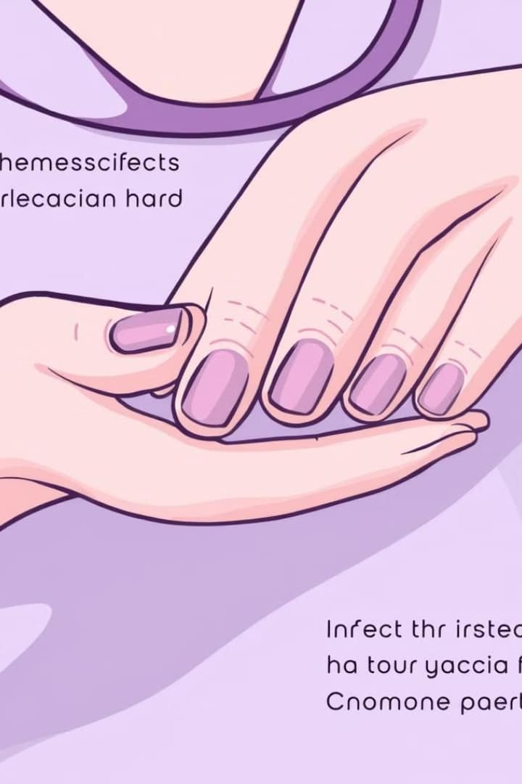
Nails
As long finger nails can have bacteria and transmit infection, nurses involved in direct patient care should follow below guidelines:
• Nails should be trimmed and not to exceed ½ inch from the tip of the finger.
• Nail polish or artificial nails including nail art should be avoided to prevent transmission of infection.
Grooming process of a professional nurse should begin from the student period itself as poor professional grooming may lead to poor image.

Slide 23


ROLE OF NURSE IN EMPOWERING OTHERS
Nurses play a vital role in empowering others, both patients and colleagues. They do this by providing education, support, and advocacy.
Nurses' Role in Empowering Junior Nurses
Build trust: It is crucial to trust the employees to complete certain tasks and achieve goals on their own.
Provide opportunities: Allow the employees to learn from their mistakes and educate them on how to avoid committing similar mistakes repeatedly.
Proper communication: Communicate your expectations clearly and ensure that the employees understand what to prioritize.
Implement feedback: Introduce a feedback system where the employees can share their experiences and seek help and advice.
Provide encouragement: It is important to let the nurses know that their opinions are valued.

Slide 24


Nurses' Role in Empowering Student Nurses
Know each students' interests: Nurse educator should take time out to know interests, hobbies and goals of each student.
Provide positive reinforcement: Praise students when they do well and provide constructive criticism when needed.
Be approachable: Be available to students and let the student know that you are there to help them.
Create innovative learning environment: Use advanced class room technology, student focused teaching methods, engage students in reflection and critical thinking process.
Provide opportunities:Inform students about the opportunities to perform clinical procedures with supervision.

Slide 25
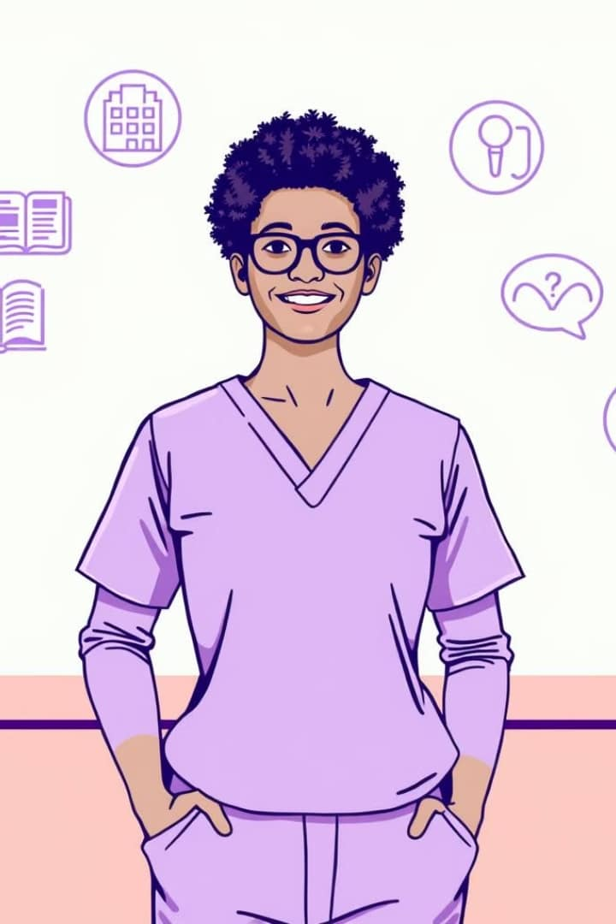
Patient Empowerment
Patient empowerment is defined as helping the patient to discover and use his innate ability to gain mastery over his health problems.
This empowerment process enables the patient to acquire knowledge, confidence. self-determination and gain greater control over decisions and actions affecting his health.

